Slide 1
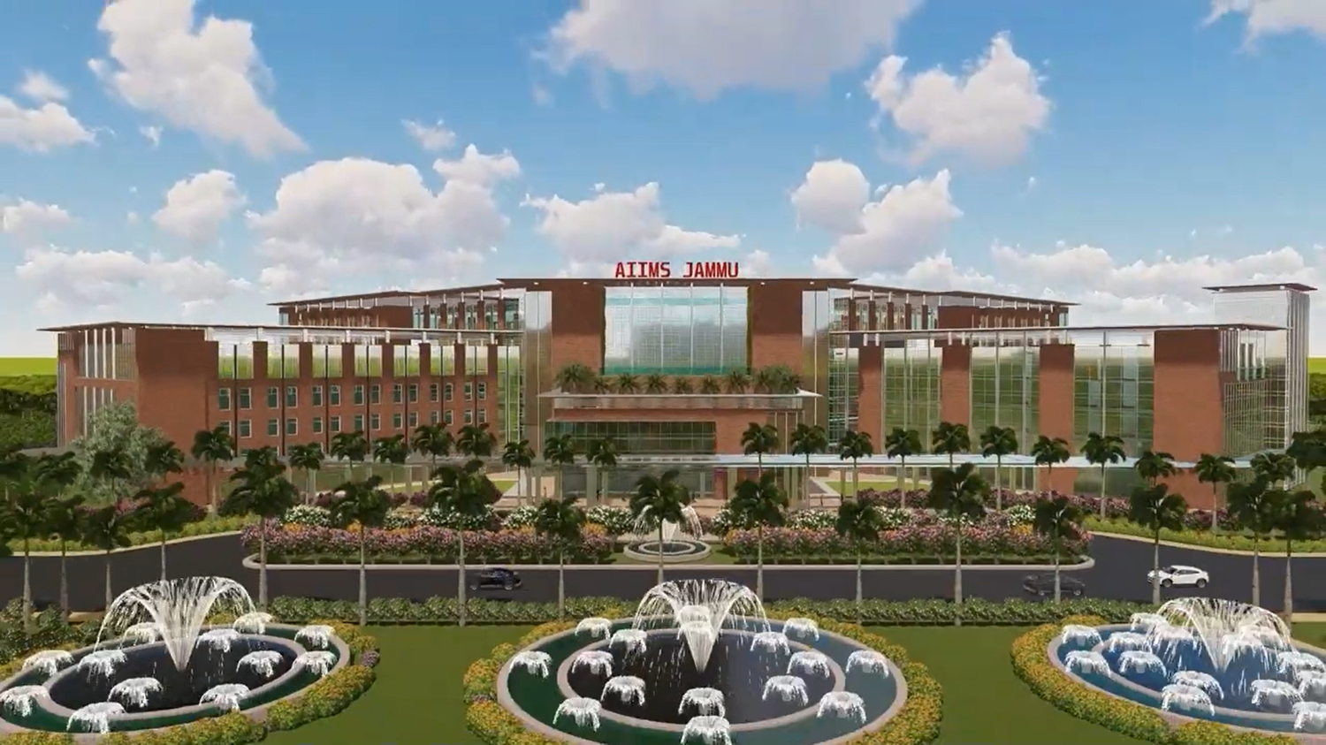
All India Institute of Medical Sciences, Vijaypur, Jammu
Welcomes
Berry Foundation Trust

Slide 2
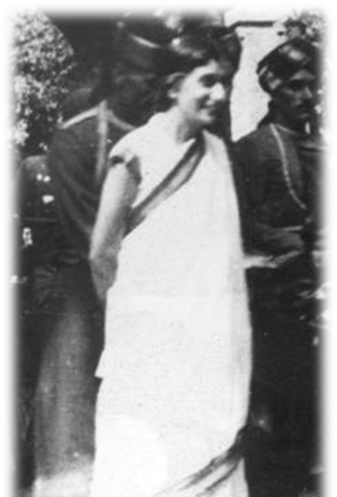
THE VISION OF THE FIRST PRESIDENT OF AIIMS
“It has been one of my cherished dreams that for post-graduate study and for the maintenance of high standards of medical education in our country, we should have an Institute of this nature in India which would enable our young men and women to have their post-graduate education in their own country”
-Rajkumari Amrit Kaur

Slide 3

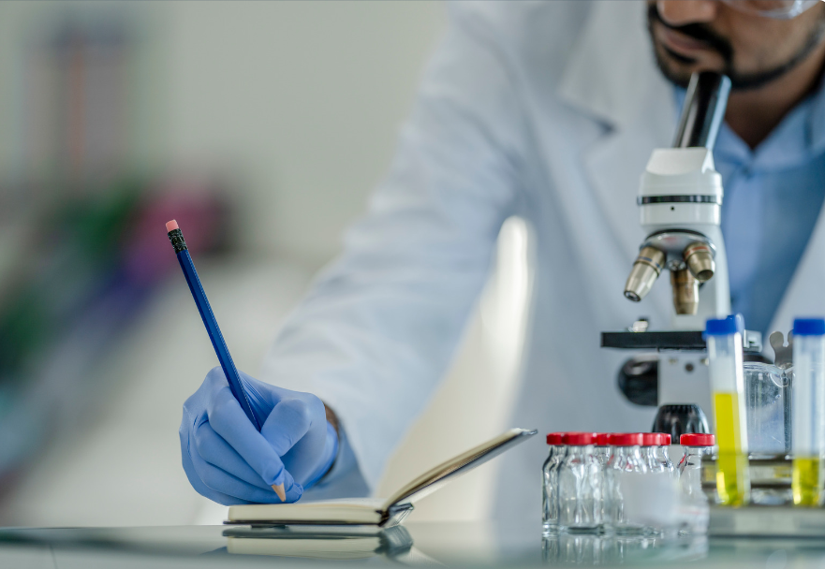
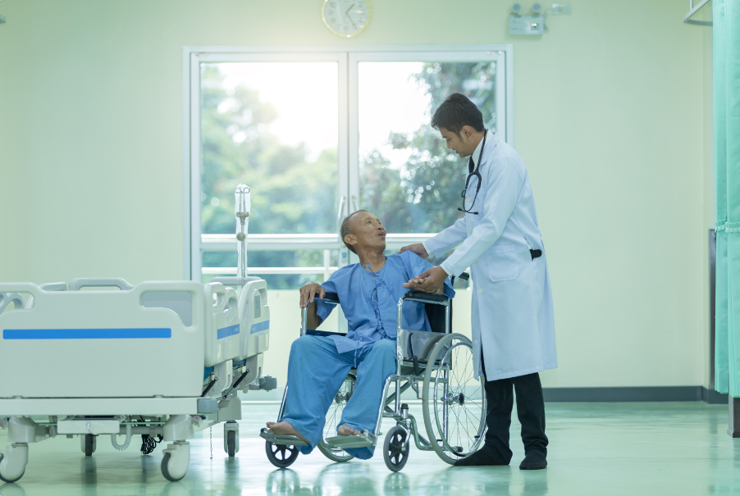
TRINITY OF MISSION
Education
Research
Patient care

Slide 4
GOVERNANCE STRUCTURE
INSTITUTE BODY
[17 members: Chaired by President, AIIMS]
GOVERNING BODY
[11 Members ,Chaired by President, AIIMS]
PRESIDENT
STANDING COMMITTEES
ACADEMIC COMMITTEE | FINANCE COMMITTEE | SELECTION COMMITTEE | ESTATE COMMITTEE | HOSPITAL AFFAIRS COMMITTEE
DIRECTOR
[C.E.O.]
Notes:
4

Slide 5
OBJECTIVES OF AIIMS
To develop patterns of teaching in undergraduate and postgraduate Medical education in all its branches, so as to demonstrate a high standard of Medical Education to all Medical Colleges and other allied Institutions.
To provide facilities of a high order for training of personnel in all important branches of health activities and also for medical research in its various aspects
To grant medical Degrees, Diplomas and other Academic distinctions which will be recognized medical Degrees for the purpose of Indian Medical Council Act, 1933.

Slide 6
SITE AREA
Total Area: 226.84 acres
North Campus: 96.9 acres
South Campus: 129.95 acres
Site area : 918636.40 Sqm
BUILDING | AREA
Hospital inc. services | 84,750 sqm
Institutional, teaching & related facilities | 42,050 sqm
Residential, common services & other facilities | 63,200 sqm
TOTAL | 1,90,000 sqm

Slide 7
Date of Cabinet Approval | 09.01.2019 (A/A & E/S received to CPWD on dt. 08.03.2019)
Timeline for completion as per Cabinet Approval | 48 Months i,e., up to March 2023
Total Project Cost | Rs. 1661 Cr. (203,225,011 USD) (Rs. 1452 Cr. (177,653,652 USD) For Construction of Hospital building and other infrastructure as per DPR submitted by CPWD + Rs.187 Cr. (22,879,637 USD) for Medical Equipment by HITES and Rs.22 Cr.(2,691,722 USD) furniture etc.)

Slide 8
Executing Agency for Construction work | Central Public Works Department (CPWD)
Contractor for EPC Contract | M/s Ahluwalia Contracts (India) Limited
Date of Award of work to Contractor | 31.01.2020 (within timelines of 1 year as per cabinet approved note)
Date of Start of work at site | 22.02.2020
Target Date of completion. | 30.04.2023
Completion timeline as per LoA to Contractor | 30 Months

Slide 9
HOSPITAL BEDS IN AIIMS Jammu
PHASE | No. of Beds
I | 750
II | 1500
III | 2200

Slide 10
BUILDING NAME | TOTAL STOREY
AYUSH BUILDING | G+1
NIGHT SHELTER | G+3
AUDITORIUM BUILDING | G+1
RESIDENTIAL BUILDINGS | G+9
HOSTEL BUILDINGS | G+6/7
ACADEMIC BUILDING | G+3/6
HOSPITAL BUILDING | B+G+3/6

Slide 11
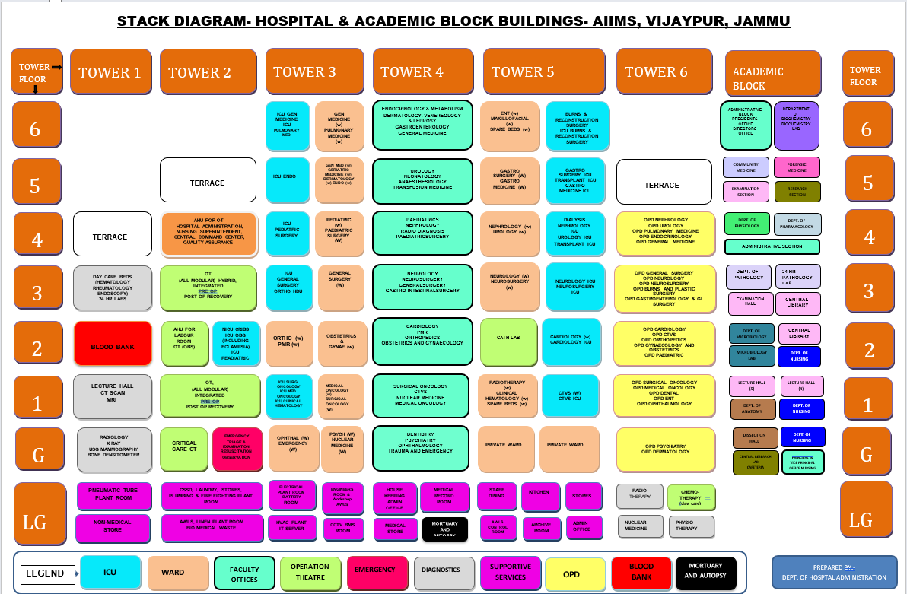

Slide 12
SALIENT FEATURES
All buildings designed for Earthquake Zone V
Total Parking provided: 3300 (Open Car space)
Connecting corridor from Medical College to Hospital.
Barrier Free Environment.
Construction of 2 Helipads
Rainwater Harvesting
1.075 MLD STP
Use of recycled water for flushing and gardening
Campus to be designed for Four Star GRIHA
425 Laborer trained under National Skills Development Mission (Target:600)

Slide 13
Latest Technologies at AIIMS Jammu
Glass fiber-reinforced concrete (GRC) Cladding System.
Double Glass unit (DGU) façade.
Plastic Road.
Occupancy sensors.
Rooftop Solar PV Panels.
Solar Poles.
Inverter type compressor and electronically communicated (EC) fan based precision air conditioning.
Power over Ethernet (PoE) Technology.
Fire Curtains.
Ceiling Fans with BLDC Motor.

Slide 14
BUDGET ALLOCATED FOR EQUIPMENT & MEDICAL FURNITURE :
185 Crores (22,634,935 USD)
MAJOR EQUIPMENTS
LINAC
PET Scan
Cath Lab
CT-256
3T-MRI
Gamma Camera
SPECT – CT
CT Simulator
Brachytherapy

Slide 15
COMMISSIONING OF AIIMS JAMMU COMPLEX
As per DPR Commissioning of AIIMS Complex is planned by September 2023 (Including Extension Period)
Proposed to be Commissioned by April/May 2023.

Slide 16
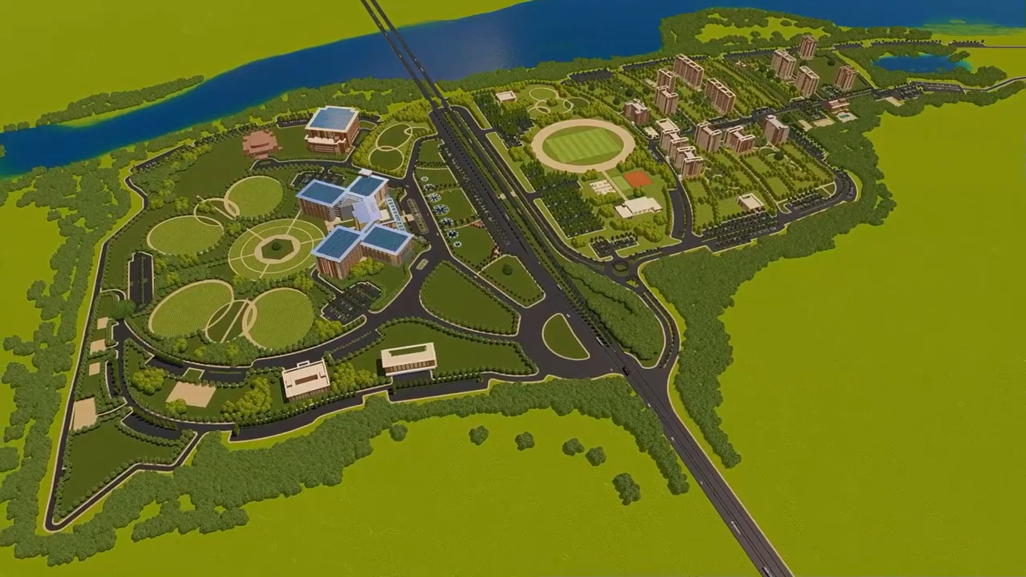
Master Plan

Slide 17
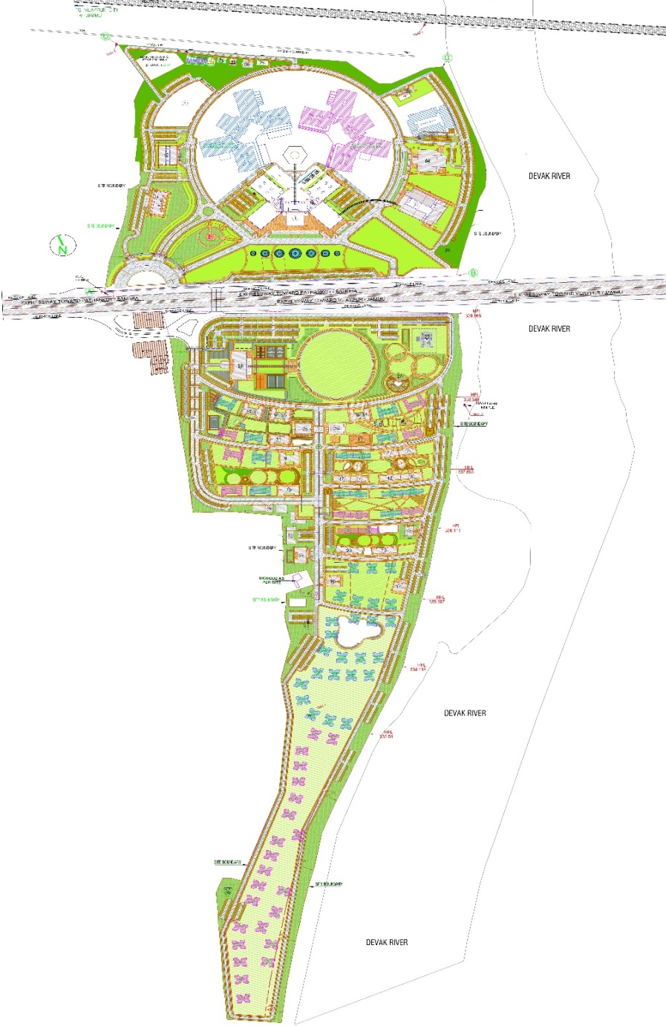
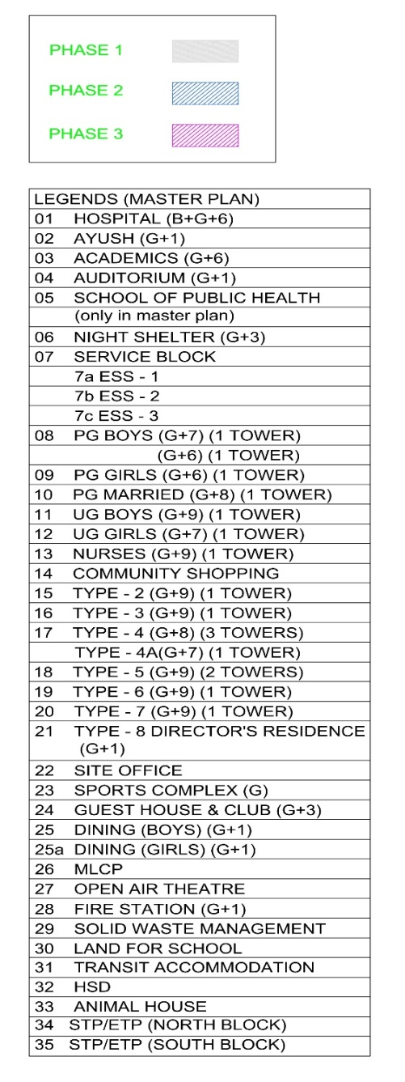

MASTER PLAN
NORTH BLOCK – PUBLIC ZONE
HOSPITAL
MEDICAL COLLEGE
AUDITORIUM
AYUSH
NIGHT SHELTER
SEMI PUBLIC ZONE
STUDENT ACTIVITY CENTRE
SPORTS COMPLEX
SOUTH BLOCK-PRIVATE ZONE
RESIDENTIAL
HOSTELS
GUEST HOUSE

Slide 18
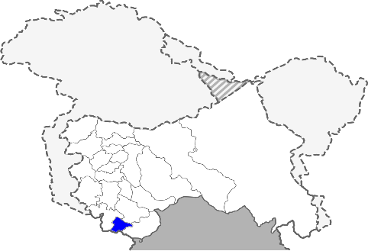
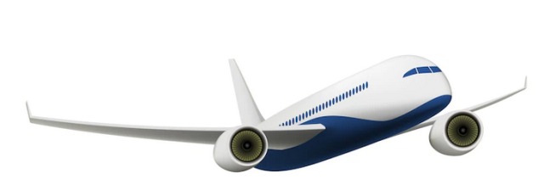

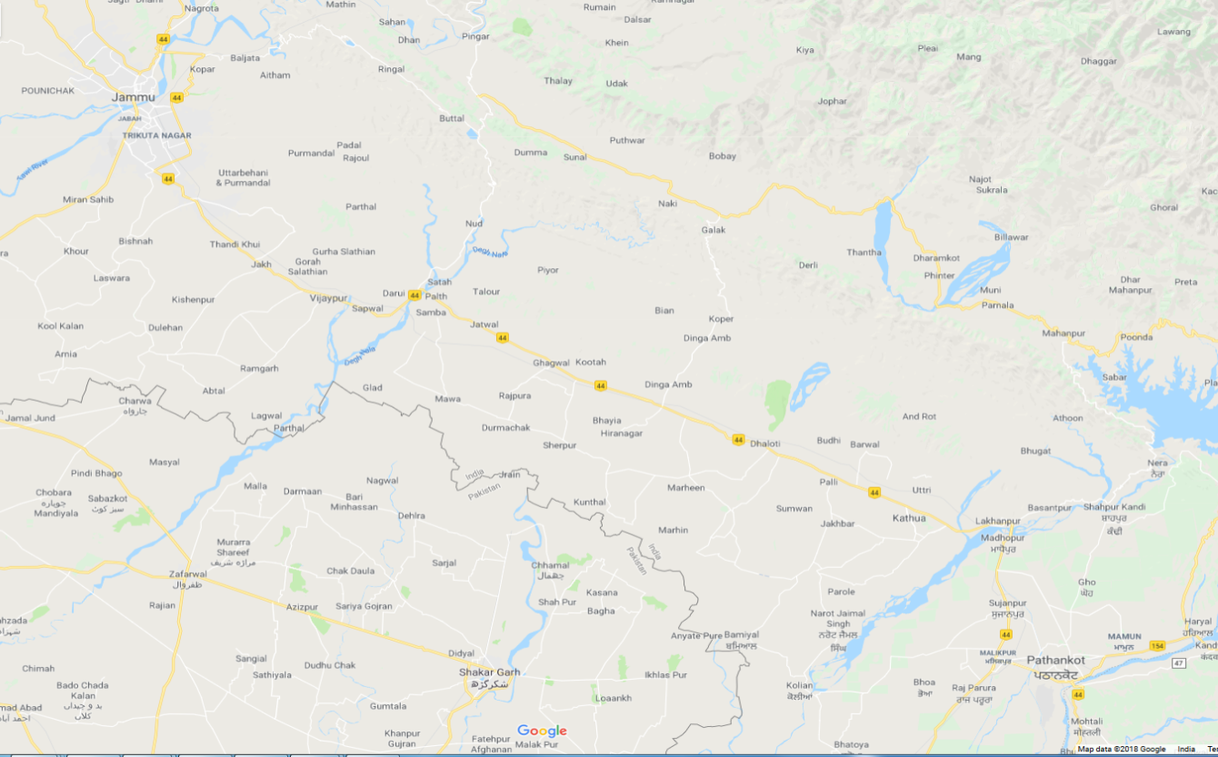


CONNECTIVITY AND LOCATION
Jammu Airport
27 Km
JAMMU CITY
SAMBA DISTRICT
Jammu
Railway Station
AIIMS
Jammu
SITE- AIIMS JAMMU
30 km
26 Km
85 km
NH 44
Jammu
Bus Stand
30 Km
PATHANKOT

Slide 19
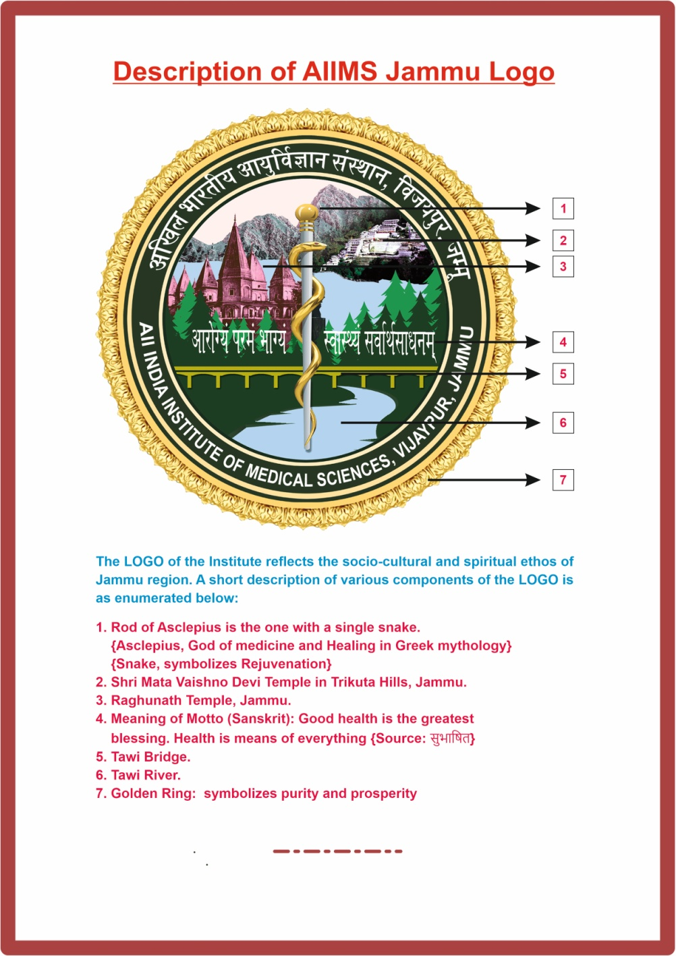

Approved by Hon’ble HFM on 30th November, 2021.

Slide 20
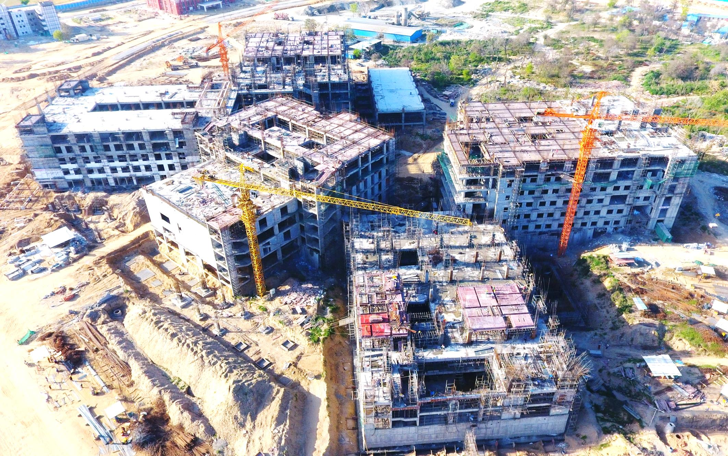
PRESENT EXECUTION AT SITE AS ON 03.11.2022
HOSPITAL BUILDING ( AERIAL VIEW )

Slide 21
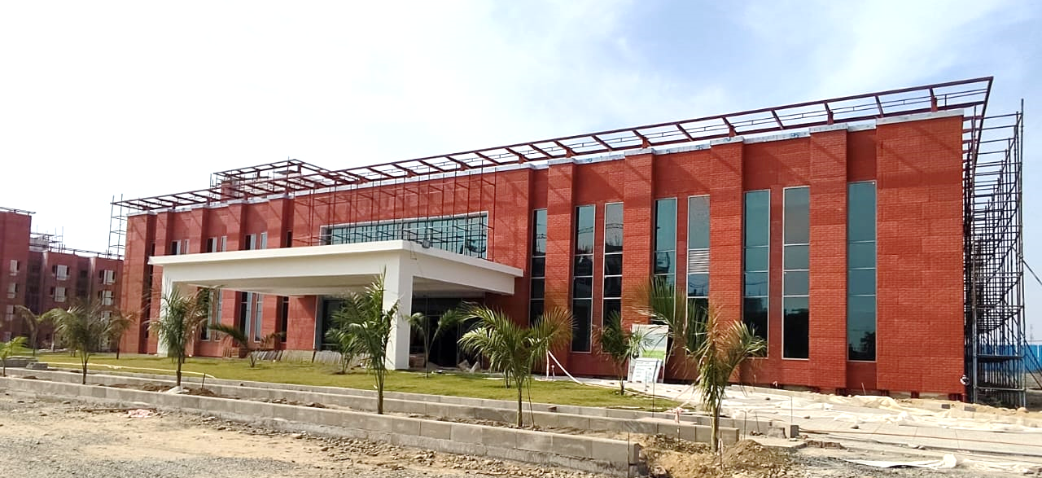
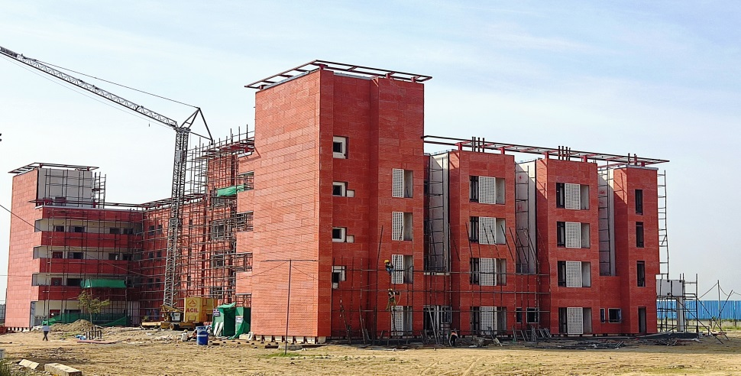
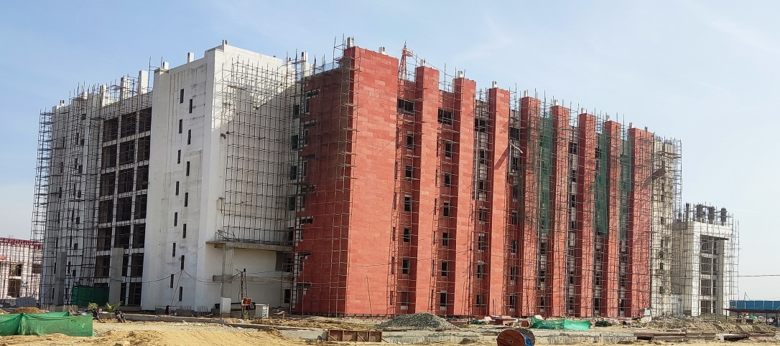
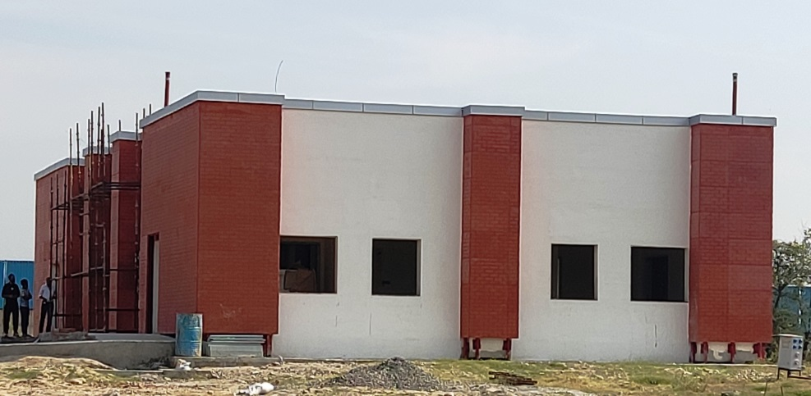
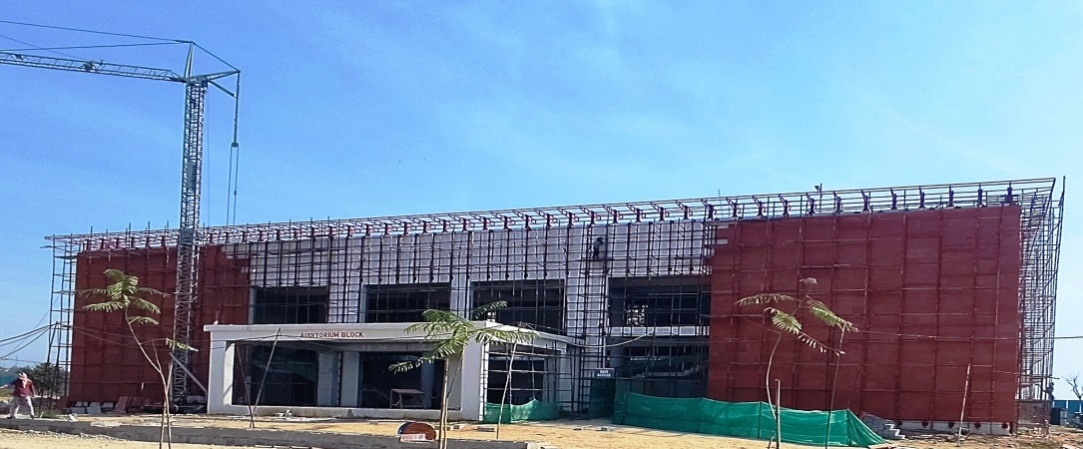
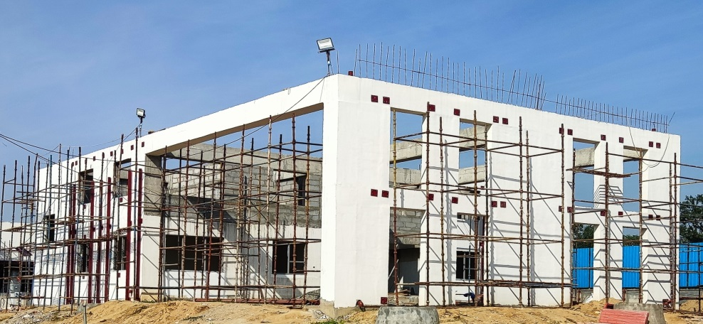
AYUSH BUILDING (G+1)
NIGHT SHELTER BUILDING (G+3)
ACADEMIC BUILDING (G+4/6)
ANIMAL HOUSE (G)
AUDITORIUM BUILDING (G+1)
FIRE STATION (G+1)

Slide 22
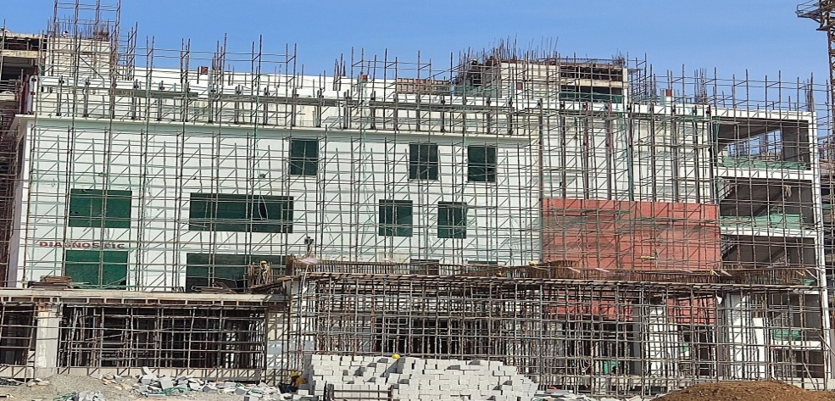
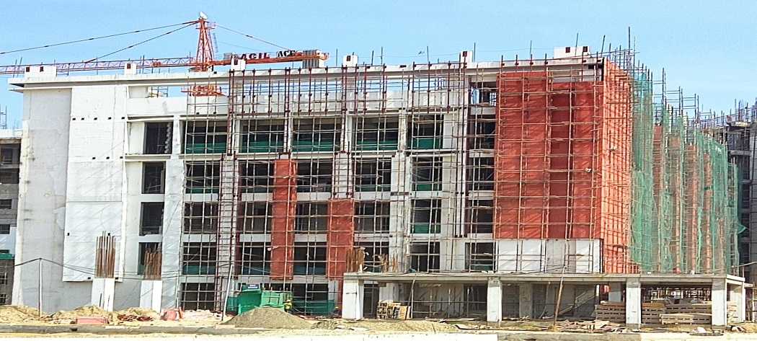
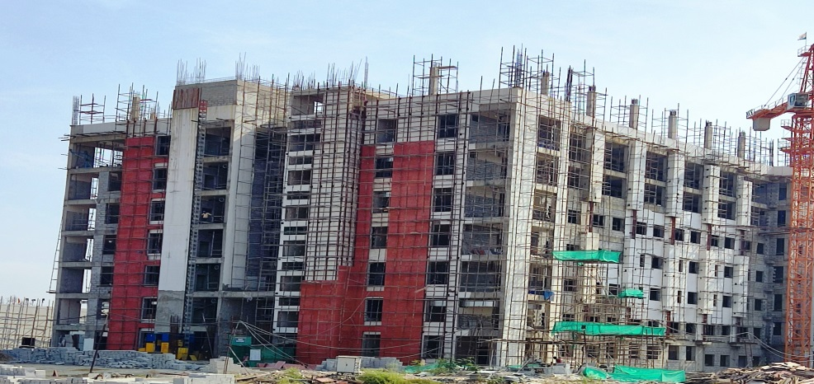
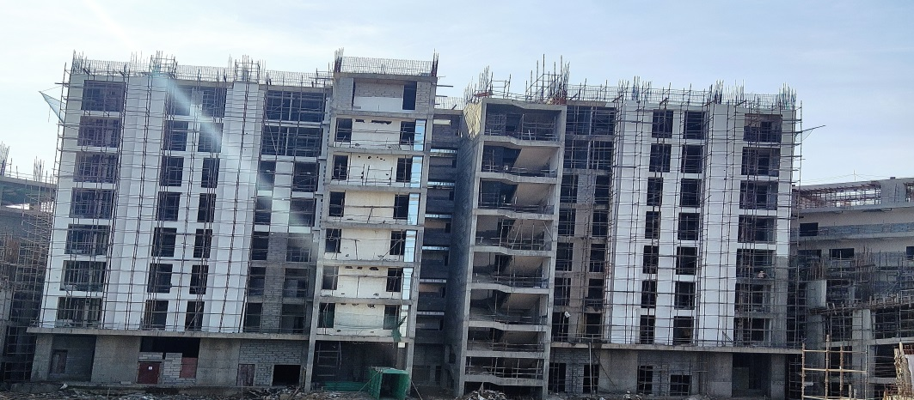
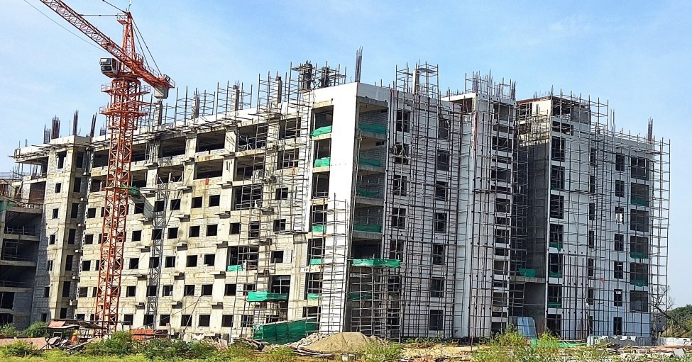
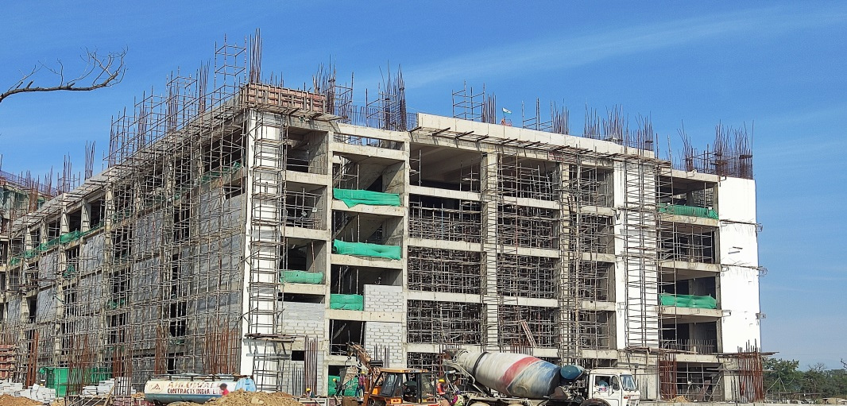
HOSPITAL TOWER – 1, Diagnostic Block (G+3)
HOSPITAL TOWER – 2, Emergency Block (B+G+4)
HOSPITAL TOWER – 3, IPD Block (B+G+6)
HOSPITAL TOWER – 4, Admin Block (B+G+6)
HOSPITAL TOWER – 5, IPD Block (B+G+6)
HOSPITAL TOWER – 6, OPD Block (B+G+4)

Slide 23
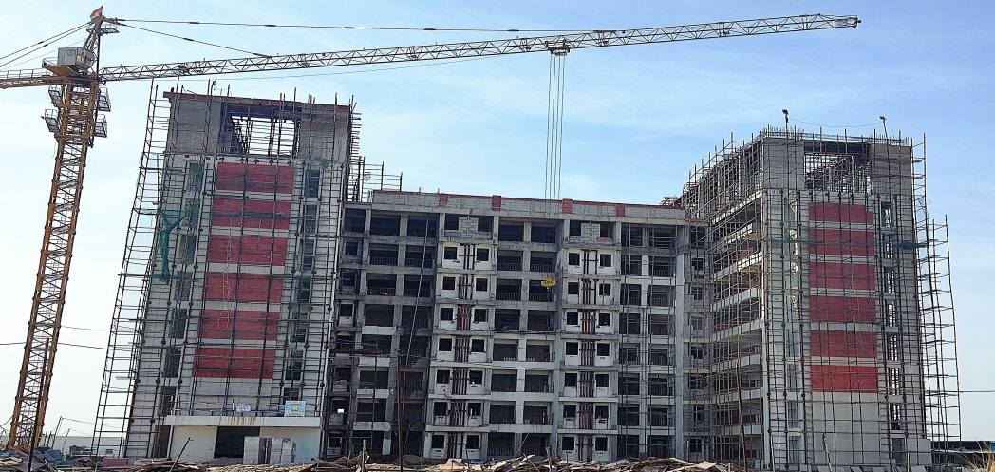
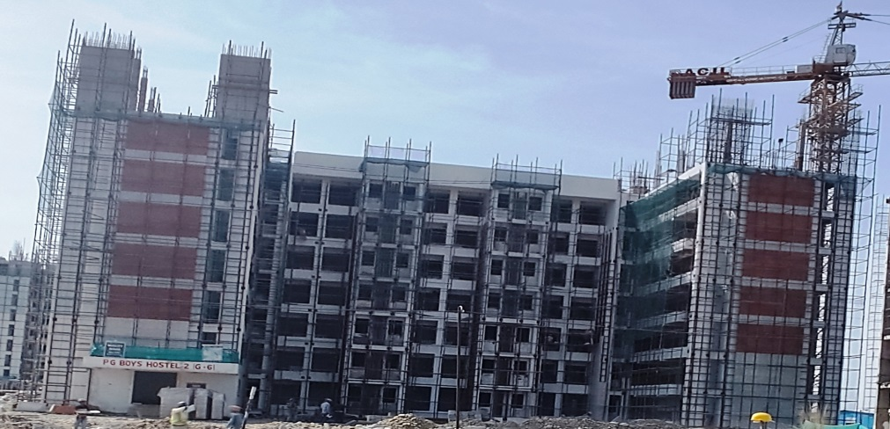
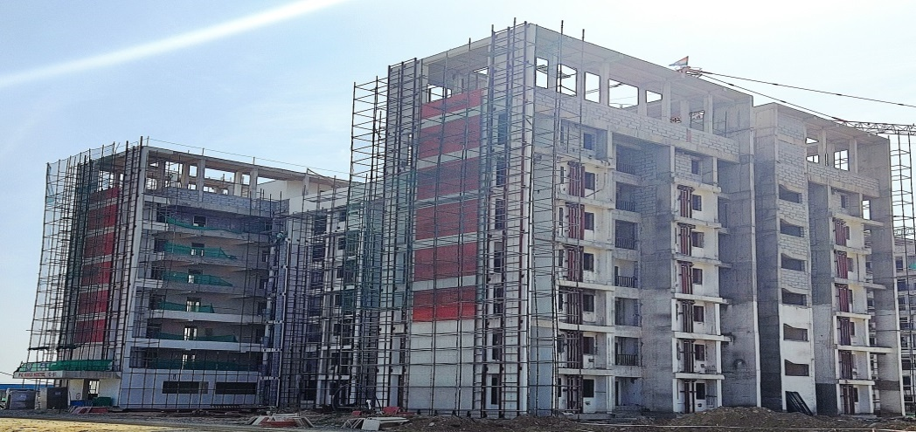
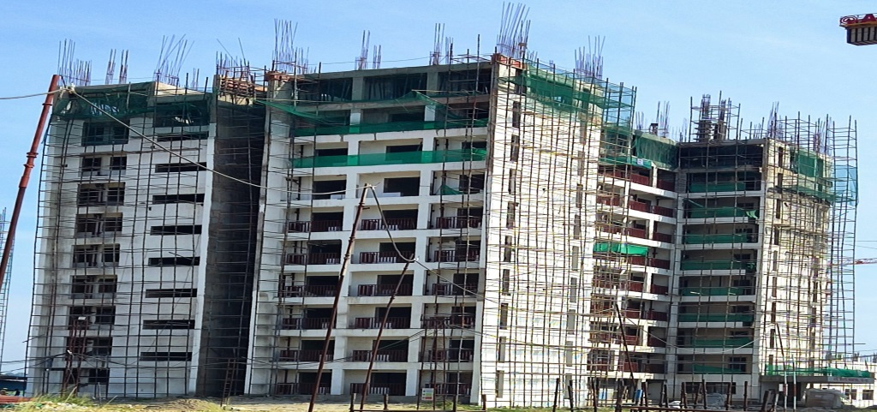
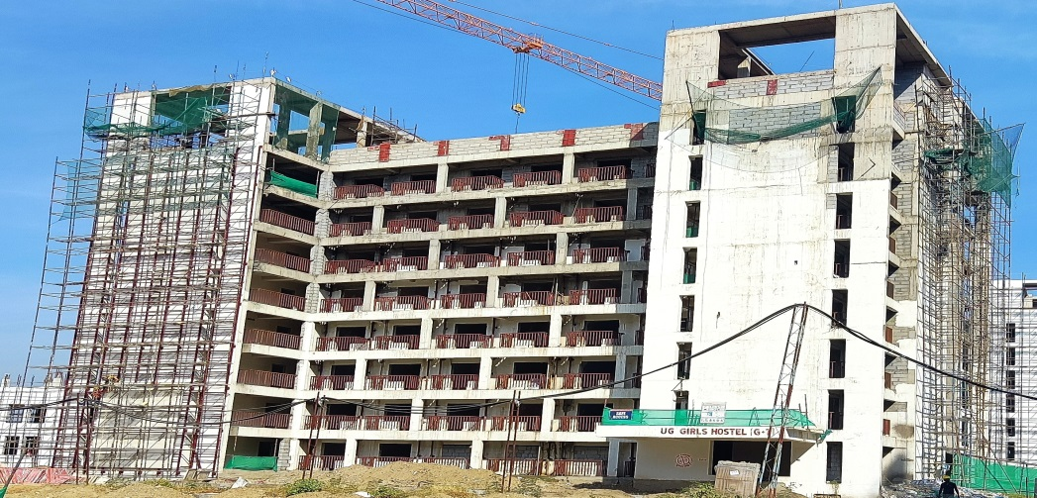
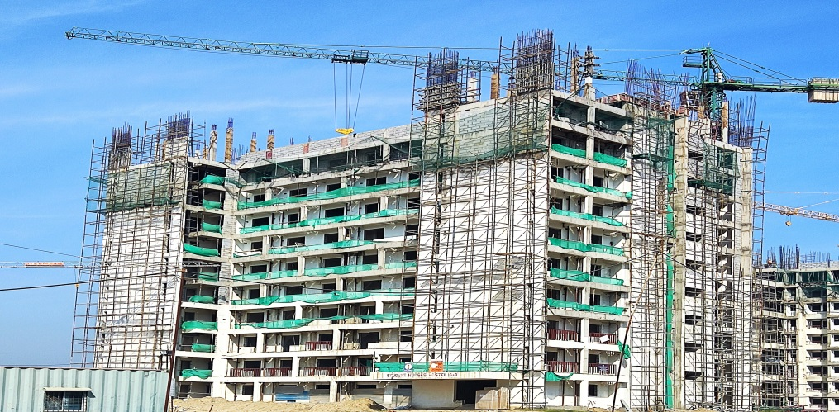
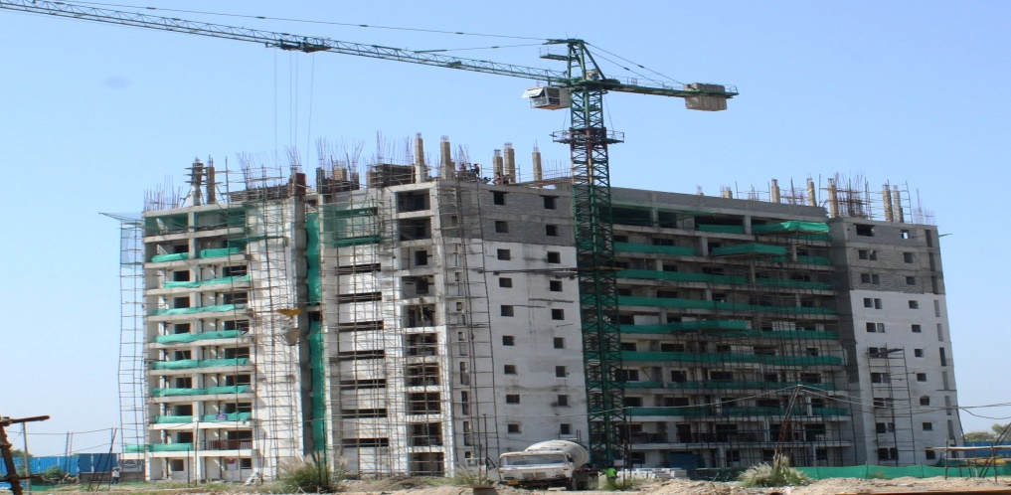
PG – BOYS T1 (G+7)
PG – BOYS T2 (G+6)
PG – GIRLS (G+6)
UG – BOYS (G+9)
UG – GIRLS (G+9)
STUDENT NURSES (G+9)

Slide 24
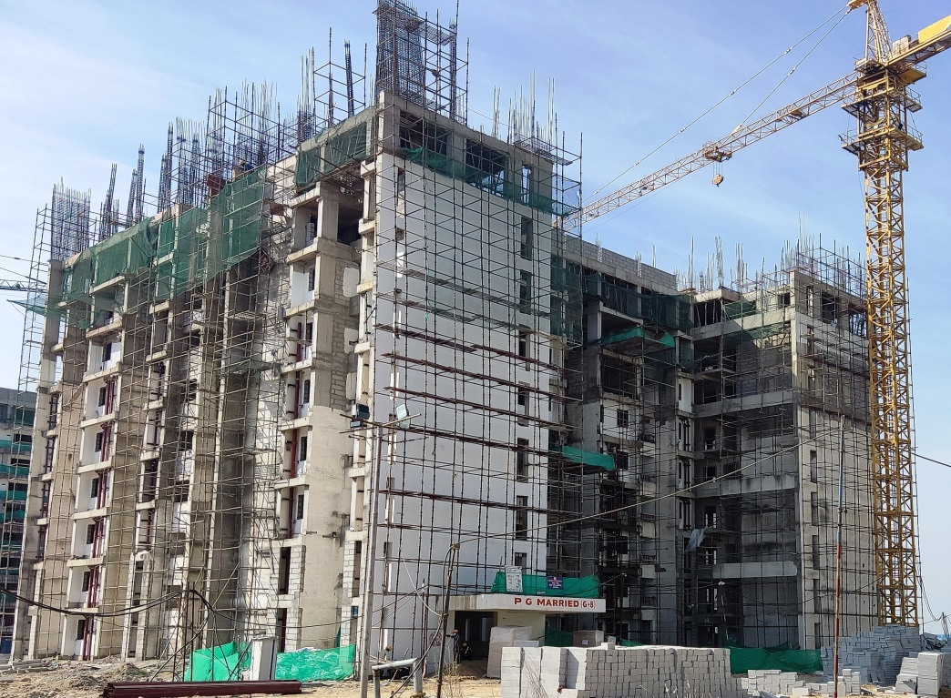
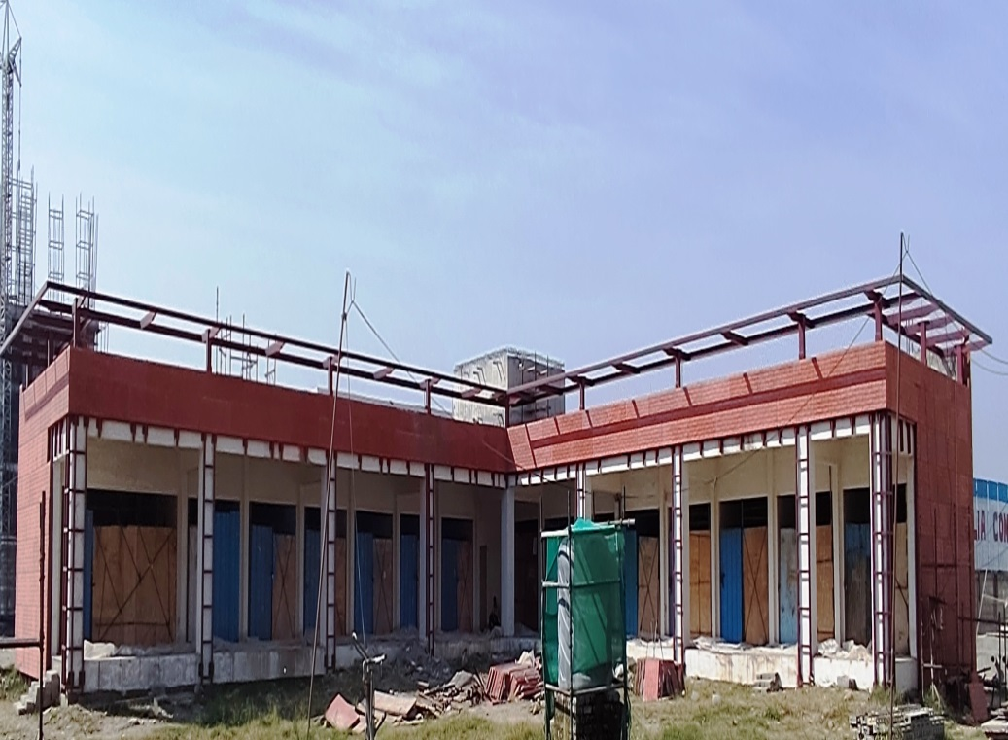
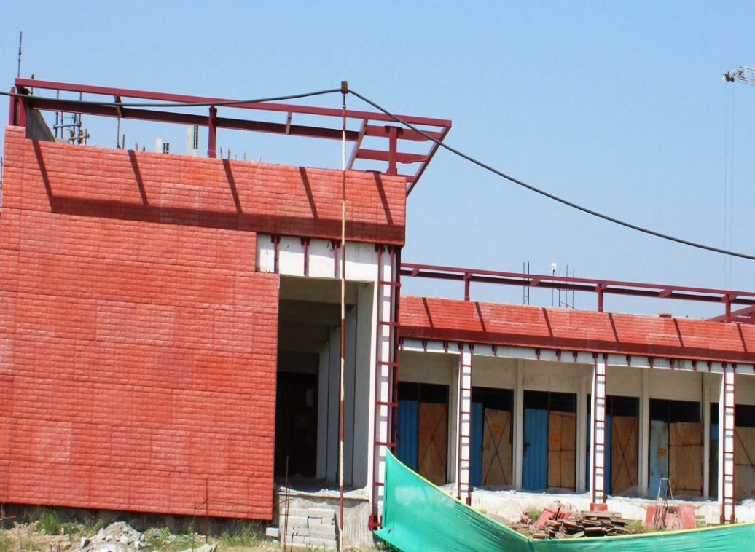
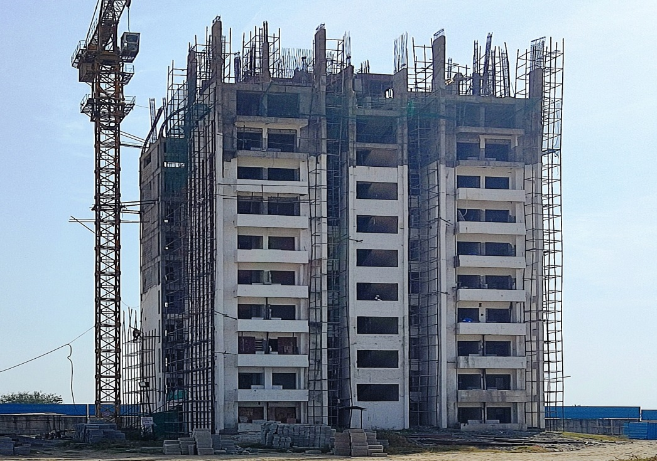
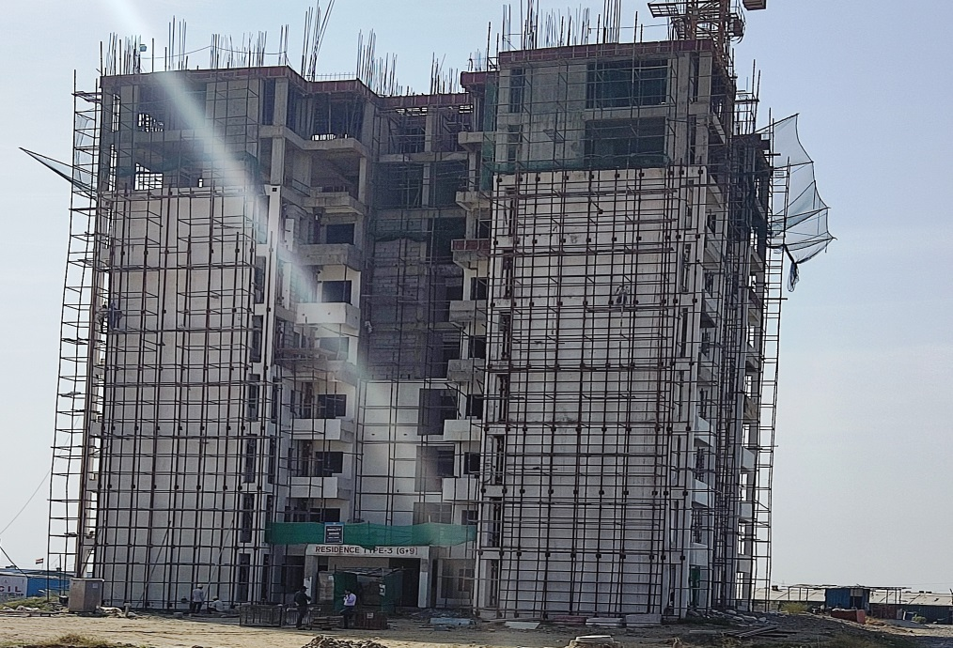
PG MARRIED (G+8)
COMMUNITY SHOPPING (G)
TYPE II (G+9)
TYPE III (G+9)

Slide 25
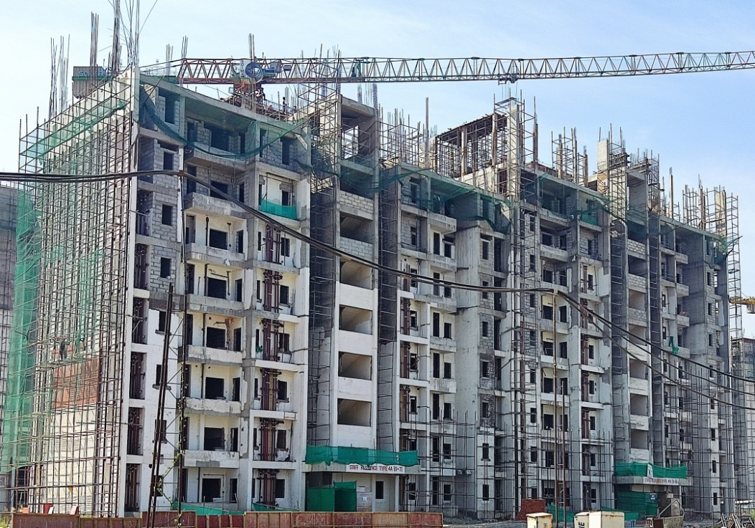
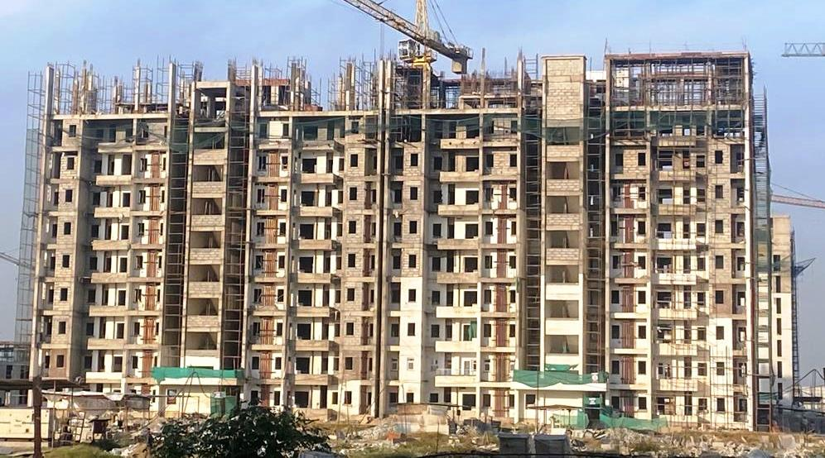
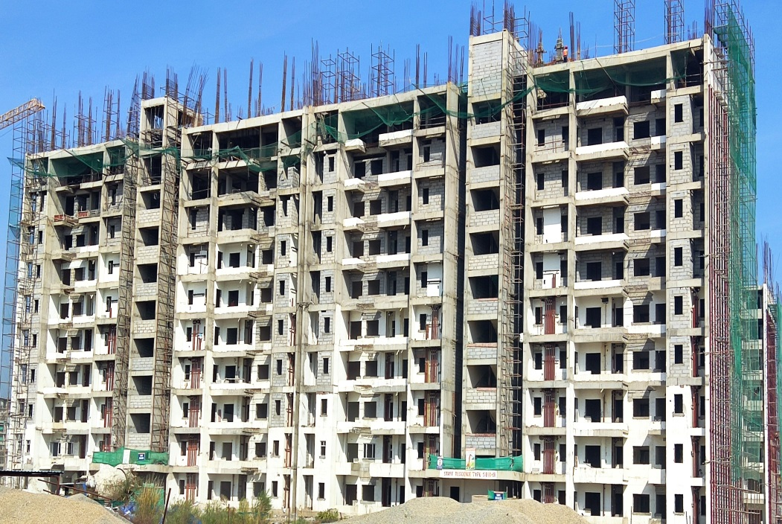
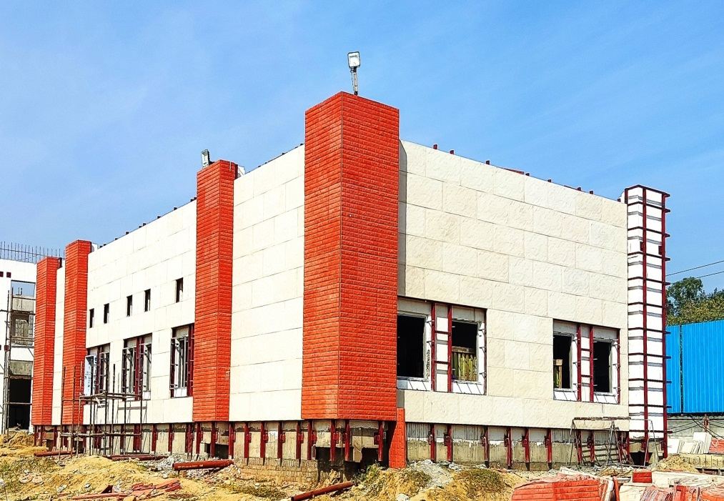
TYPE IV-A (G+7) & IV-B (G+8)
TYPE IV-C (G+8) & IV-D (G+8)
TYPE 5 A (G+9) & 5B (G+9)
SWM

Slide 26
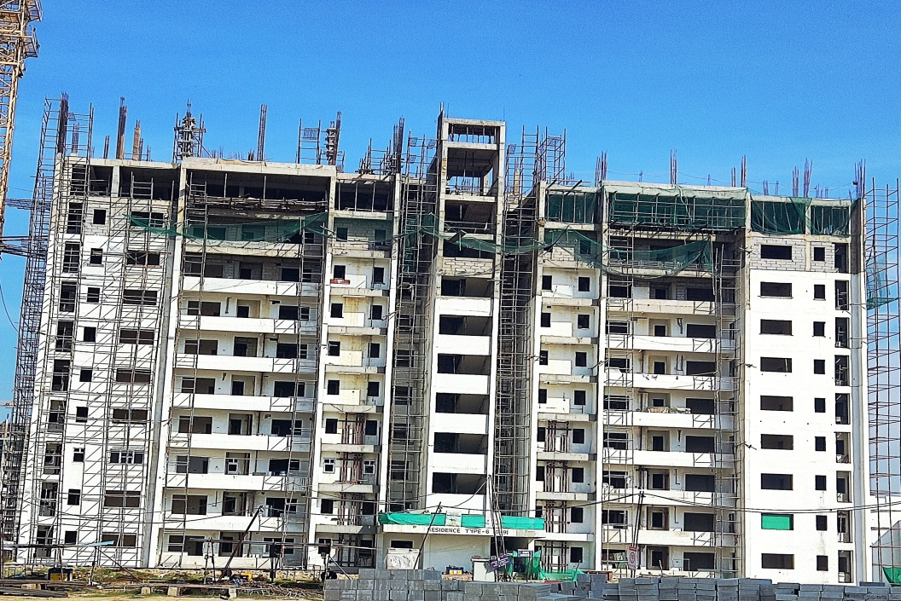
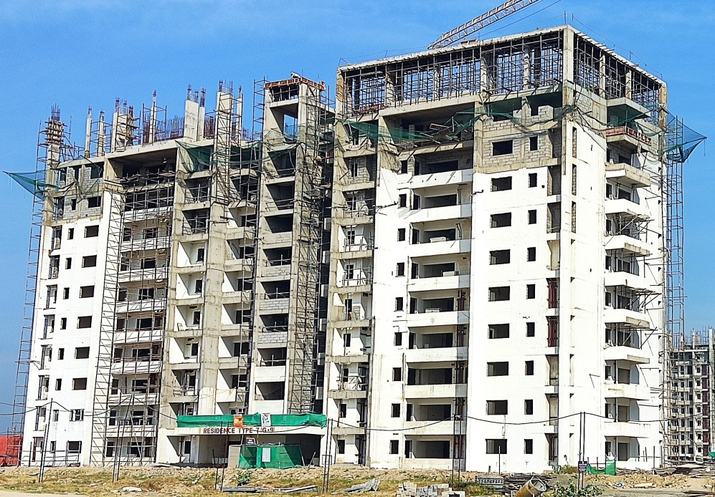
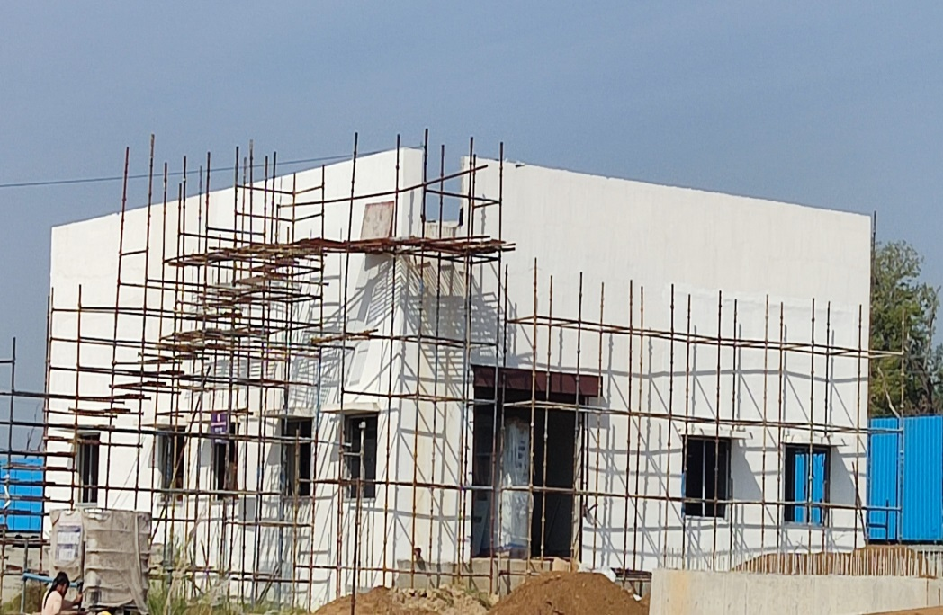
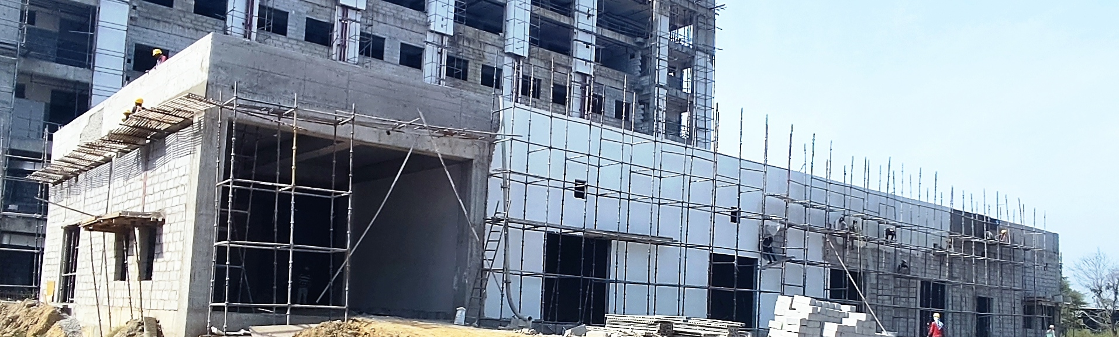
TYPE VI (G+9)
TYPE VII (G+9)
ESS 7A.1
ESS 7A.2

Slide 27
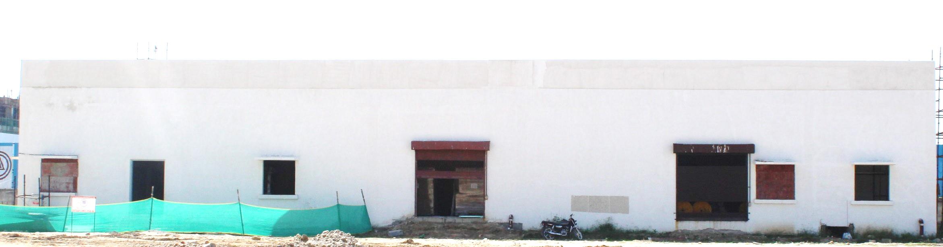
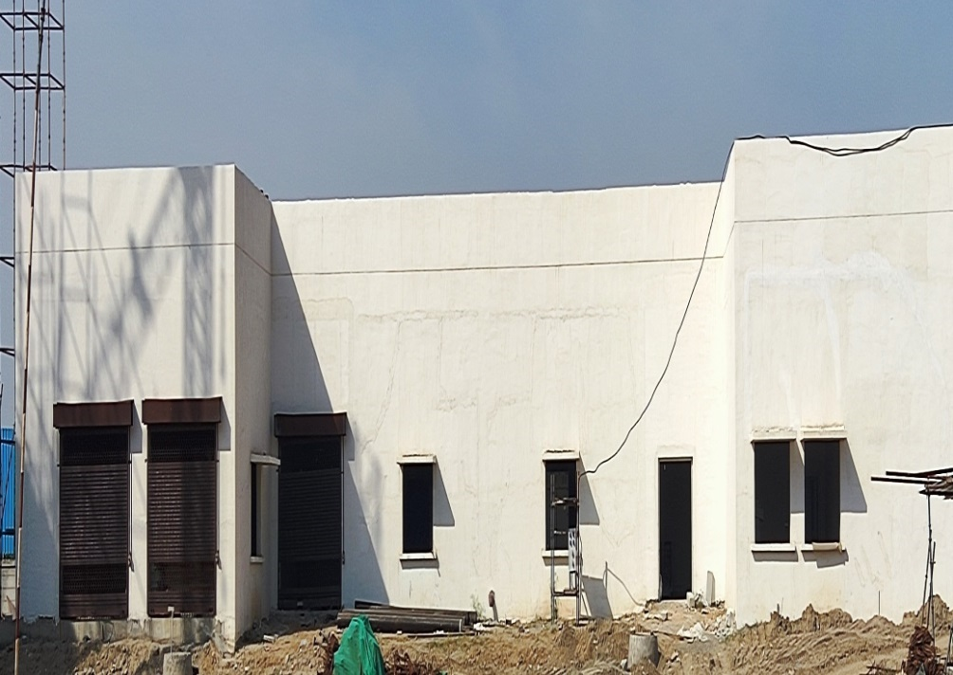
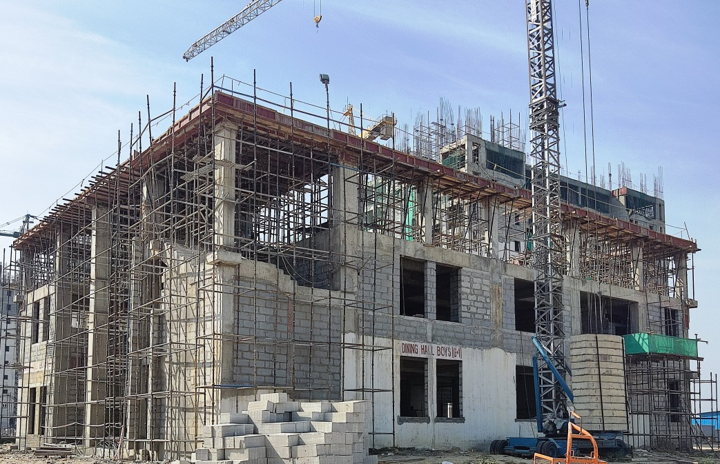
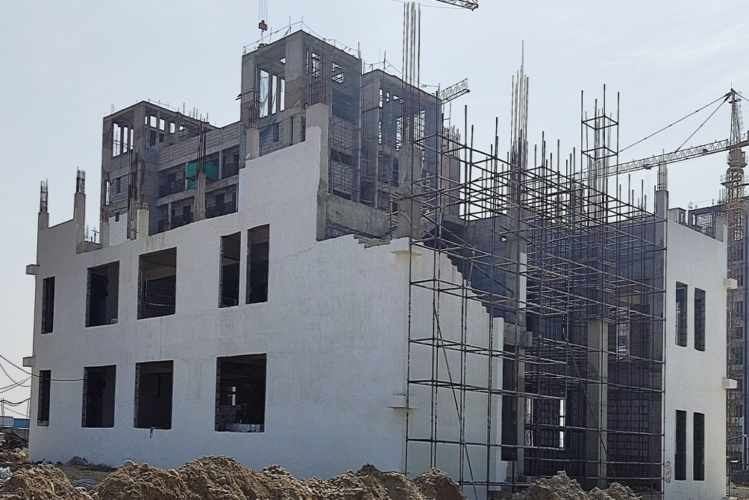
ESS 7B
ESS 7C
DINING BOYS
DINING GIRLS

Slide 28
INTAKE CAPACITY
Medical college: 125 MBBS students/year
Nursing college: 60 B.Sc. Nursing Students/year
Current Intake:
1st Batch of MBBS Students : 50 Nos.
2nd Batch of MBBS Students: 61 Nos.

Slide 29
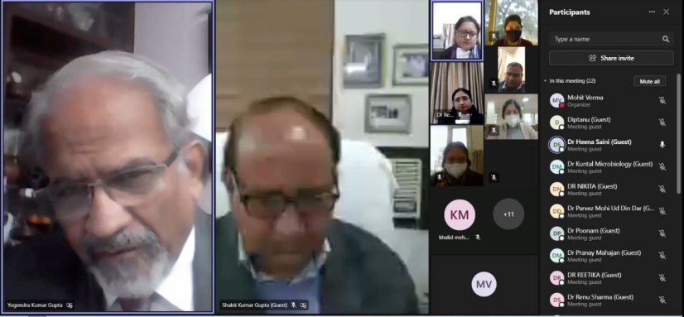

UPDATE ON AIIMS JAMMU
PROGRESS & ACCOMPLISHMENTS
Enrolled 1st year MBBS Students: 50 Nos
Enrolled 2nd year MBBS Students: 61Nos
Online classes of 1st Batch of 50 students for
their 2nd year MBBS started w.e.f 15th Jan 2022
Both batches shifted to Jammu since 15th March
Address to Faculty by President AIIMS Jammu
Address to Students by Director AIIMS Jammu
Hon’ble Shri Manoj Sinha, Governor of UT of J&K
alongwith President AIIMS Jammu inaugurated the
Plantation Drive was launched from AIIMS, Vijaypur, Jammu
on 30th July 2022.

Slide 30

MAKESHIFT HOSTEL/ ACADEMIC BLOCK
Hostel :
Accommodates minimum 180 students (1st & 2 nd Batch MBBS Students)
Lodging, Dining, Recreation, Sports
Security, Medical Assistance, WiFi, Laundry, Grocery
Academic Block :
Faculty Offices
03 Lecture Halls
Demonstration Rooms
Library
Auditorium
NITS Miran Sahib, Jammu
Approx. 5 acres (48,000 sqft)

Slide 31







Slide 32
POST GRADUATE PROGRAMMES
Courses | To be started From July, 2023
MD/MS/MDS
DM/MCh
MSc/M Biotech/PhD
Fellowships & Observership

Slide 33
PG/PhD Programme to be started at AIIMS Jammu

Slide 34
S.No | Department | Course | Faculty at present | Faculty Experience as in March 2022 | No. of proposed seats | Session/year
1. | Anatomy | MD, PhD | 2 Associate + 2 Assistant Professors | 6 year 10 months 12 years 3 years | 2 | June 2023
2. | Physiology | MD | 3 Assistant Professors | 4 years plus 4 years plus 3 years plus | - | Jan 2024*
3. | Biochemistry | MD, PhD | 1 Professor** + 3 Assistant Professors | 6 years plus 4 years plus | - | Jan 2024* **will attain 70 years in March 2023

Slide 35
S.No | Department | Course | Faculty at present | Faculty Experience as in March 2022 | No. of proposed seats | Session/year
4. | Pathology | MD | 4 Assistant Professors | 6 years plus 4 years plus 4 years plus 3 years plus | - | Jan 2024*
5. | Pharmacology | MD, PhD | 4 Assistant Professors | 4 years plus 4 years plus 3 years plus 3 years plus | - | Jan 2024*
6. | Forensic Medicine & Toxicology | MD | 1 Professor+1 Assistant Professor | 5 years plus | 2 | June 2023

Slide 36
S.No | Department | Course | Faculty at present | Faculty Experience as in March 2022 | No. of proposed seats | Session/year
7. | Microbiology | MD | 2 Assistant Professors | 3 years plus 3 years plus | - | Jan 2023
8. | ENT | MS | 1 Associate Professor | Not joined yet | 1 | Jan 2024
9. | Community Medicine | MD | 1 Additional +1 Associate + 5 Assistant Professors | 25 years plus 4 years plus 4 years plus 4 years plus 3 years plus 3 years plus | 4 | June 2023

Slide 37
S.No | Department | Course | Faculty at present | Faculty Experience as in March 2022 | No. of proposed seats | Session/year
10. | Ophthalmology | MS | 1 Professor +1 Associate + 2 Assistant Professors | 20 years plus 6 years plus 3 years plus | 4 | June 2023
11. | General Medicine | MD | 2 Assistant Professors | 8 years plus 6 years plus | - | Jan 2024*
12. | General Surgery | MS | 1 Associate + 2 Assistant Professors | 8 years plus 3 years plus | 1 | Jan 2024*
13. | Paediatrics | MD | 1 Associate + 2 Assistant Professors | 5 years plus | 1 | Jan 2024*

Slide 38
S.No | Department | Course | Faculty at present | Faculty Experience as in March 2022 | No. of proposed seats | Session/year
14. | Obstetrics and Gynaecology | MD | 1 Professor +1 Associate+2 Assistant Professors | 17 years plus 16years plus 4 years plus 3 years plus | 3 | June 2023
15. | Anaesthesiology | MD | 1 Additional+1 Associate+2 Assistant Professors | 16 years plus 9 years plus 7 years plus 4 years plus | 3 | June 2023
16. | Conservative Dentistry | MDS | 1 Professor | 16 years plus | 2 | June 2023

Slide 39
S.No | Department | Course | Faculty at present | Faculty Experience as in March 2022 | No. of proposed seats | Session/year
17. | Oral Surgery | MDS | 1 Assistant Professor |  | - | Jan 2024*
18. | Hospital Administration | MD/PhD | 2 Professors + 2 Assistant Professor |  | - | June 2023
19. | Orthodontics | MDS | 1 Assistant Professor | 3 years plus | - | Jan 2024*

Slide 40
S.No | Department | Course | Faculty at present | Faculty Experience as in March 2022 | No. of proposed seats | Session/year
20. | Orthopaedics | MS | 2 Associate + 2 Assistant Professor | 13 years plus 7 years plus 3 years plus | 2 | June 2023
21. | Psychiatry | MD | 2 Assistant Professors |  | - | Jan 2024*
22. | Radio-diagnosis | MD | 1 Assistant Professor |  | - | Jan 2024*

Slide 41
S.No | Department | Course | Faculty at present | Faculty Experience as in March 2022 | No. of proposed seats | Session/year
23. | Radiotherapy | MD | 1 Professor | 16 years plus | 2 | June 2023
24. | Transfusion Medicine and Blood Bank | MD | 2 Assistant Professors | 8 years plus 3 years plus | - | Jan 2024*

Slide 42
Approval for creation of these departments proposed separately
S.No | Department | Course | Faculty at present | Faculty Experience as in March 2022 | No. of proposed seats | Session/year
25. | Family Medicine*** | MD | Nil |  | NA
26. | Biostatistics | PhD | Nil |  | NA
27. | Biophysics | Msc/PhD/MD | Nil |  | NA

Slide 43
S.No | Department | Course | Faculty at present | Faculty Experience as in March 2022 | No. of proposed seats | Session/year
28. | Geriatric Medicine | MD/PhD | Nil |  | NA
29. | Haematology | DM (Hematopathology) & Haematology | Nil |  | NA
30. | Rheumatology | DM | Nil |  | NA
31. | Transplant Immunology & Immunogenetics | Short term courses | Nil |  | NA

Slide 44
Super-speciality courses to begin after MD/MS courses are operational for three years
S.No | Department | Course | Faculty at present | Faculty Experience as in March 2022 | No. of proposed seats | Session/year
32. | Cardiology | DM | Nil |  | NA
33. | Cardiothoracic Surgery | McH | 1 Assistant Professor |  | Nil
34. | Surgical Gastroenterology | DM | 1 Assistant Professor |  | Nil

Slide 45
S.No | Department | Course | Faculty at present | Faculty Experience as in March 2022 | No. of proposed seats | Session/year
35. | Endocrinology & Metabolism | DM/PhD | 1 Assistant Professor |  | Nil
36. | Medical Oncology | DM | Nil |  | Nil
37. | Nuclear Medicine | MD/DM Therapeutic/PhD/ MSC (Nuclear Medicine Technology)

Slide 46
S.No | Department | Course | Faculty at present | Faculty Experience as in March 2022 | No. of proposed seats | Session/year
38. | Neonatology | DM
39. | Neurosurgery | McH | 1 Assistant Professor |  | Nil
40. | Pediatric Surgery | McH | 1 Additional + 1 Assistant Professor
41. | Gastroenterology | DM | Nil |  | Nil
42. | Neurology | DM | Nil |  | Nil

Slide 47
S.No | Department | Course | Faculty at present | Faculty Experience as in March 2022 | No. of proposed seats | Session/year
43. | Nephrology | DM | 1 Assistant Professor |  | Nil
44. | Pulmonary Medicine | DM | Nil |  | Nil
45. | Urology | McH | Nil |  | Nil

Slide 48
S.No | Department | Course | Faculty at present | Faculty Experience as in March 2022 | No. of proposed seats | Session/year
46. | Physical Medicine & Rehabilitation |  | Nil |  | Nil
47. | Trauma & Emergency Medicine | MD | 1 Assistant Professor | 8 years plus 5 years plus 5 years plus | Nil
48. | Dermatology | MD | Nil |  | Nil

Slide 49


MEMORANDUM OF UNDERSTANDING- NATIONAL
28th August 2021
29th January 2022
AIIMS & IIM Jammu
AIIMS & IIM & IIT Jammu
AIIMS & University of Jammu
AIIMS & CSIR –IIIM Jammu

Slide 50

MEMORANDUM OF UNDERSTANDING- NATIONAL
20th April 2022
Rashtriya Ayurveda Vidyapeeth
(National Academy of Ayurveda)
Autonomous Organization under Ministry of Ayush, GoI

Slide 51

MEMORANDUM OF UNDERSTANDING- NATIONAL
21st February 2022
AIIMS Jammu
IIM Jammu
IIT Jammu
& Research Foundation of Hospital & Healthcare Administration, New Delhi
14 June 2022
Johnson & Johnson Private Limited- Establishment of Simulation Lab for Surgical Skills
07th March 2022
AIIMS &
Himalayan Research Institute for Yoga & Naturopathy, (KAYAKALP) Palampur, (Himachal Pradesh)
for Research in Ayush

Slide 52



UPDATE ON AIIMS JAMMU
MBA (Hospital Administration and HealthCare Management)
Launched on 23th October 2021
Jointly by AIIMS, IIM and IIT Jammu.
1st of its kind Nationally & probably Internationally
Enlisted in CAT (60 Seats)
Teaching by eminent faculty of all the 3 INIs
1st batch Classes Commenced on 17th July 2022

Slide 53
Surgical Skill Development Lab:
Developed at the Makeshift Campus located at Miran Sahib.
To be utilized for Development & upgradation of Surgical Skills among Faculty and Students.
To train the Paramedical & Nursing Staff on BLS & ALS.

Slide 54


MEMORANDUM OF UNDERSTANDING- INTERNATIONAL
07th March, 2022
University of Alabama at Brimingham (UAB), USA for Innovation, Entrepreneurship & Startups in Healthcare Industry.

Slide 55
Update on AIIMS Jammu
Actions Planned
Collaborations/ Memorandums of Understanding under consideration:
( National )
Central University Jammu
Shri Mata Vaishno Devi University, Katra
Industrial Biotech Park, Kathua, J&K
Indian Institute of Mass Communication, Jammu
Cluster University of Jammu
JSS Academy of Higher Education & Research, Sri Shivarathreeshwara Nagara, Karnataka, India

Slide 56
Update on AIIMS Jammu
Actions Planned
Collaborations/Memorandums of Understanding under consideration:
( International )
Monash University, Australia for combined research project on EMR in line with Digital AIIMS initiative
Sheba Medical Center (SMC), Govt. of Israel for collaboration and establishment of Institute of Traumatology.

Slide 57
Update on AIIMS Jammu
Actions Planned
Teleconsultation Facilities:
Planned from January, 2023.
Focus on UT of J&K and Ladakh and adjoining states.
12 hours Teleconsultation from 08:00 AM to 08:00 PM
Faculty and Resident Doctors.

Slide 58
UPDATE ON AIIMS JAMMU
PROGRESS & ACCOMPLISHMENTS
Global Conference: “World Congress on Next Generation Healthcare” in 2023
Multiple Management Development Programs/Short-term Training Programmes:
HxMDP : 20th to 27th November 2022 for Senior Healthcare Professionals.
Leadership Development Programme in Healthcare.
Financial Management for Non-Finance people.
Logistic & Supply Chain Management.

Slide 59
UPDATE ON AIIMS JAMMU
(PROPOSED FACILITIES UNDER CONSIDERATION)
Establishment of :-
Centre of Excellence in Telemedicine and Telecare
Centre of Excellence in Trauma Sciences and Institute of Traumatology
Centre of Excellence in Nursing
Digitization of AIIMS Jammu (Including MIS)
Centre of Excellence in Comprehensive Cancer Care
Centre of Excellence for Advance Studies in Hospital Administration

Slide 60
UPDATE ON AIIMS JAMMU
(PROPOSED FACILITIES UNDER CONSIDERATION)
Establishment of :-
IT enabled simulation and skill development facility
Research Center and International Collaborations
Centre of Excellence in Ophthalmology including Skill Development
Department of Quality & Patient Safety
Skill Development Simulation Centre
Centre of Excellence in Dental Sciences
Digital Museum

Slide 61
UPDATE ON AIIMS JAMMU
(PROPOSED FACILITIES UNDER CONSIDERATION)
Development of Centers for Robotics/Techno surgery
Development of AIIMS offsite Campus/Satellite Centers- Community Outreach Program
Centre for Predictive Medical Technology
Training of Teachers, Students, Police personnel, Drivers, Housewives etc. in First Aid & CPR.

Slide 62
UPDATE ON AIIMS JAMMU
(PROPOSED FUTURE FACILITIES)
Industry-Academia Interface for Research
AIIMS Jammu- a Global Village
Guest House for International Faculty & Researchers.
AYUSH: National Institute of Integrated Healthcare.

Slide 63
GLIMPSES
OF
AIIMS JAMMU

Slide 64




AIIMS JAMMU IN NEWS
17th June 2022
17th June 2022
17th June 2022
16th June 2022

Slide 65








AIIMS JAMMU IN NEWS
25th February 2022
31st January 2022
30th January 2022
30th January 2022
3rd March 2022
24th January 2022
14th Dec 2021

Slide 66


Slide 67


15TH AUGUST 2021 – INDEPENDENCE DAY CELEBRATION

Slide 68


FIRST INSTITUTE BODY MEETING OF AIIMS JAMMU : 19TH AUGUST, 2021

Slide 69




FIRST PLANTATION DRIVE – 20TH AUGUST, 2021

Slide 70




FIRST PMC MEETING OF AIIMS JAMMU : 20TH AUGUST, 2021

Slide 71



mou for collaboration between institutes of national importance at jammu
( IIT Jammu, IIM Jammu, AIIMS Jammu, University of Jammu ) (28th August 2021)

Slide 72




Review of progress of AIIMS Jammu and signing of MOU between AIIMS Jammu and
CSIR-IIIM Jammu in presence of Hon’ble Minister Dr Jitendra Singh : 29th Januaray 2022

Slide 73




Celebration of international yoga day- 2022

Slide 74


Slide 75




Celebration of national doctor’s day- 2022

Slide 76




Celebration of Independence Day, 2022

Slide 77






DISTRIBUTION OF CERTIFICATES OF APPRECIATION TO STAFF FOR OUTSTANDING CONTRIBUTION

Slide 78

आरोग्यं परमं भाग्यं
स्वास्थ्यं सर्वार्थसाधनम्
“Good health is the greatest blessing.
Health is the means of everything”.

